Slide 1
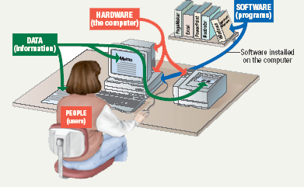
Parts of the Computer System
Computer systems have four parts
Hardware
Software
Data
User
1B-*

Slide 2
Parts of the Computer System
Hardware
Mechanical devices in the computer
Anything that can be touched
Software
Tell the computer what to do
Also called a program
Thousands of programs exist
1B-*
Notes:
*
Teaching tip
Suggest to your students that the majority of people who purchase computers do so because of software. They want to email, or type letters. Nearly every reason given to purchase a computer is based on software needs.

Slide 3
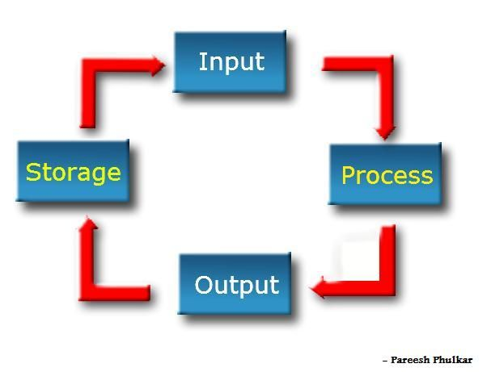
Information Processing Cycle
Steps followed to process data
Input
Processing
Output
Storage
1B-*
Notes:
*
Teaching tip
It is helpful to walk through a simple program to demonstrate the cycle. I often use a simple arithmetic problem to show this cycle.

Slide 4
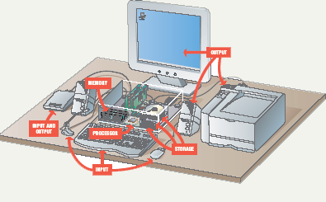
Essential Computer Hardware
Computers use the same basic hardware
Hardware categorized into four types
1B-*

Slide 5
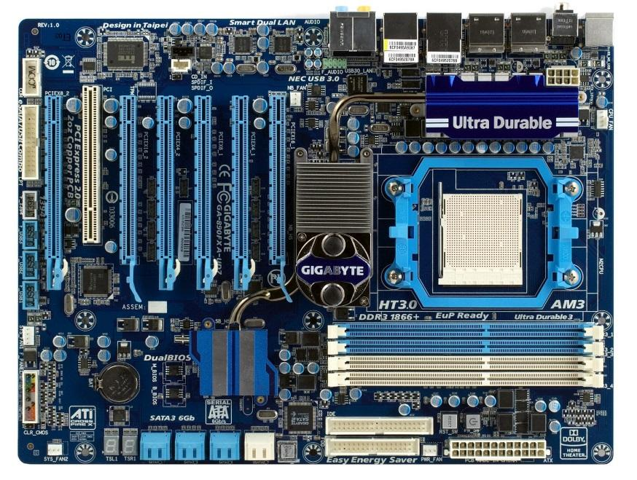
Essential Computer Hardware
Motherboard
The main circuit board that connects to many different components
this board is the "mother" of all components
1B-*

Slide 6
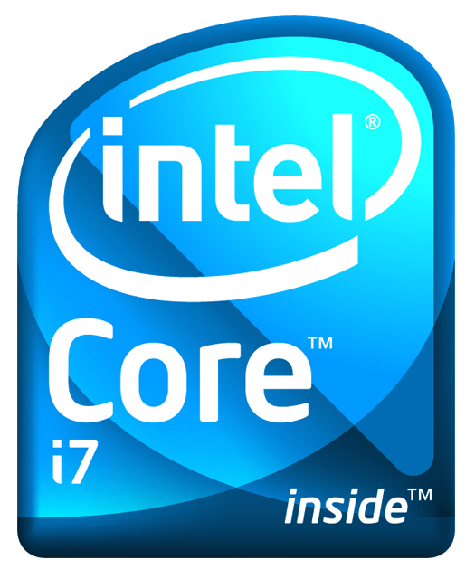
Essential Computer Hardware
Processing devices
Brains of the computer
Carries out instructions from the program
Manipulate the data
Most computers have multiple processors
Central Processing Unit (CPU)
Secondary processors
Processors made of silicon and copper
1B-*
Notes:
*
Teaching tip
The interaction between a CPU and secondary processors is much like the interaction between a boss and subordinate. The boss tells the subordinate what to do but not necessarily how to accomplish the task. The subordinate only bothers the boss when guidance or more data is needed.

Slide 7
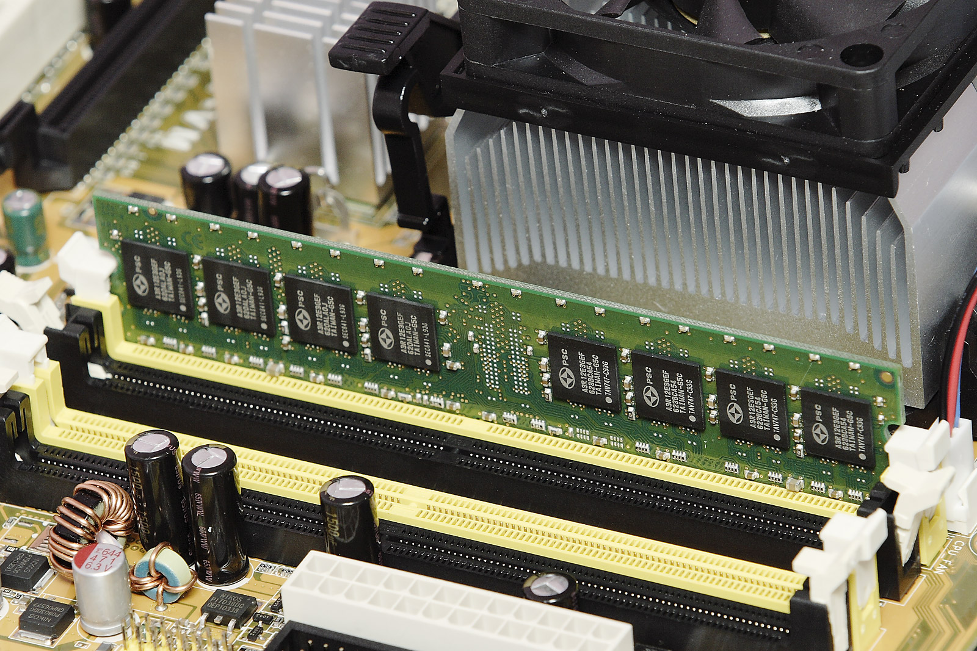
Essential Computer Hardware
Memory devices
Stores data or programs
Random Access Memory (RAM)
Volatile
Stores current data and programs
More RAM results in a faster system
Read Only Memory (ROM)
Permanent storage of programs
Holds the computer boot directions
1B-*
Notes:
*
Insider information
Intel, the manufacturer of popular CPUs, originally made RAM for mainframe and minicomputers. Today Kingston is a leading RAM manufacturer.
Chapter 5 discusses ROM and the BIOS. Refer your students to this chapter if they desire more information.

Slide 8
Essential Computer Hardware
Input and output devices
Allows the user to interact
Input devices accept data
Keyboard, mouse
Output devices deliver data
Monitor, printer, speaker
Some devices are input and output
Touch screens
1B-*
Notes:
*
Teaching tip
It is helpful to have examples of input and output devices in class. Stories of obscure input output devices are typically well received by the students.

Slide 9
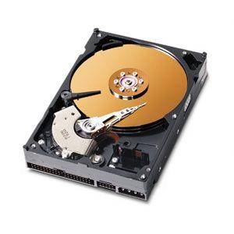
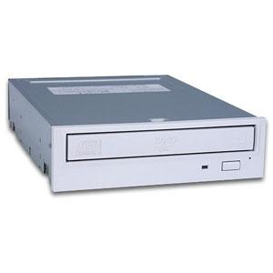
Essential Computer Hardware
Storage devices
Hold data and programs permanently
Different from RAM
Magnetic storage
-hard drive
Uses a magnet to access data
Optical storage
CD and DVD drives
Uses a laser to access data
1B-*
Notes:
*
Insider information
A new CD technology is emerging. A shorter wavelength blue laser beam is being used to burn CD’s. This allows more data to be saved on a disk. The technology is in it’s infancy but should be mature in the near future.
Chapter 11 of the text provides more detail regarding storage devices.
DVD writers are available for purchase. They have not been standardized yet. Several competing formats are vying for acceptance. Of these, the DVD+RW seems to have the strongest support.

Slide 10
Software Runs The Machine
System software
Most important software
Operating system
Windows XP, windows 8, Chrome
Network operating system (OS)
Windows Server 2012
Utility
Symantec AntiVirus
1B-*

Slide 11
Software Runs The Machine
Application software
Accomplishes a specific task
Most common type of software
MS Word
Covers most common uses of computers
1B-*

Slide 12
Computer data
Stored using the binary number system
Data can be organized into files
1B-*
Notes:
*
Teaching tip
Chapter 5 in the text explores data processing in greater detail.
Figure 1B.5 shows data in binary format.

